Slide 1
Lending Club Case Study analysis
- Sreedhar K R (kr_Sreedhar@yahoo.com)
- Chandeep Singh Arora (chandeeparora19@gmail.com)

Slide 2
Problem statement
Lending Club is an online market-place where 2 types of people come together for business – The borrower who wants to borrow money for various purposes (credit card payment, marriage etc.) and the investor who wants to lend money to earn interest ultimately.
As a company, Lending Club wants to identify the risky loan applicants who have higher chances of defaulting so that credit loss to the company is reduced as much as possible. There is a need to identify some consumer and loan attributes to meet this purpose.

Slide 3
Assumptions
Below assumptions have been made :
Only Fully paid and Charged Off customers will be considered from the data set as Current ones are the people who are already paying the loan and won’t be adding a lot of value to the analysis.
All the numeric values will be considered up to 2 decimal places.

Slide 4
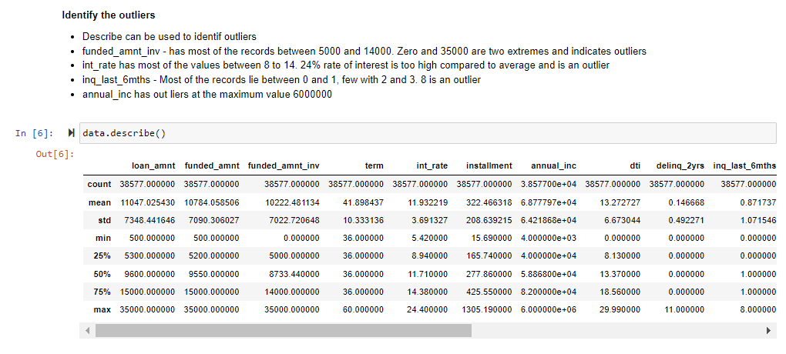
Discussion on outliers

Slide 5
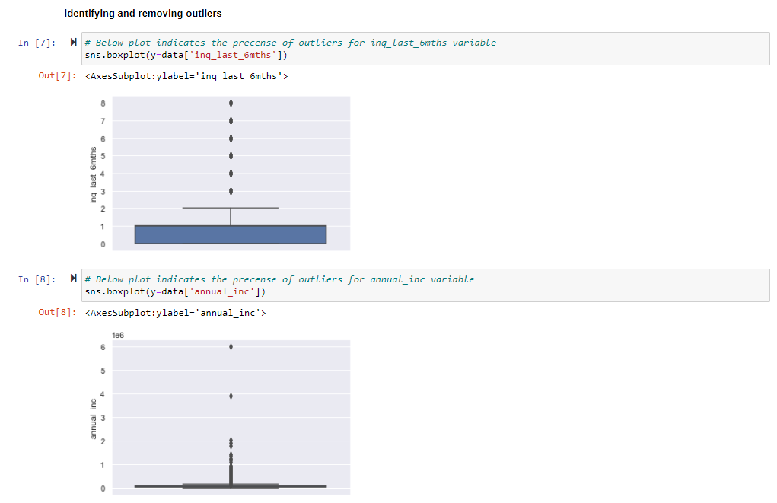
Discussion on outliers

Slide 6
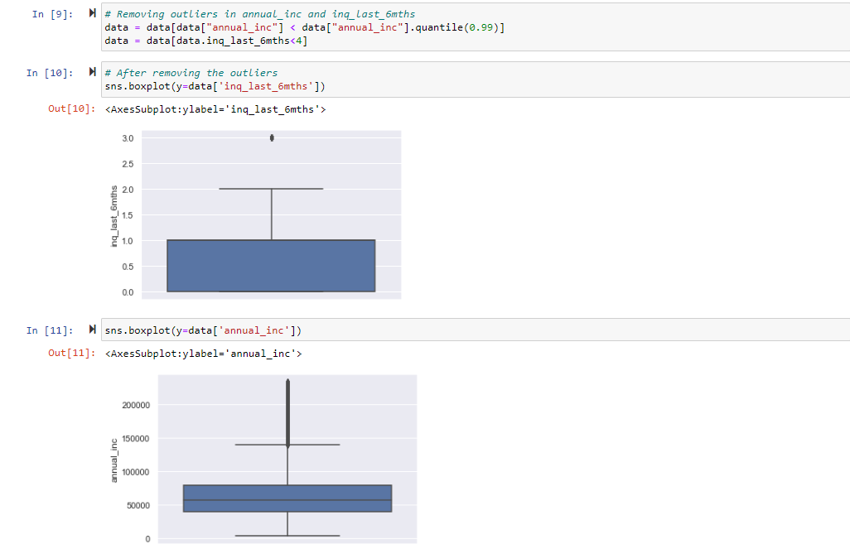
Discussion on outliers

Slide 7
Analysis

Slide 8
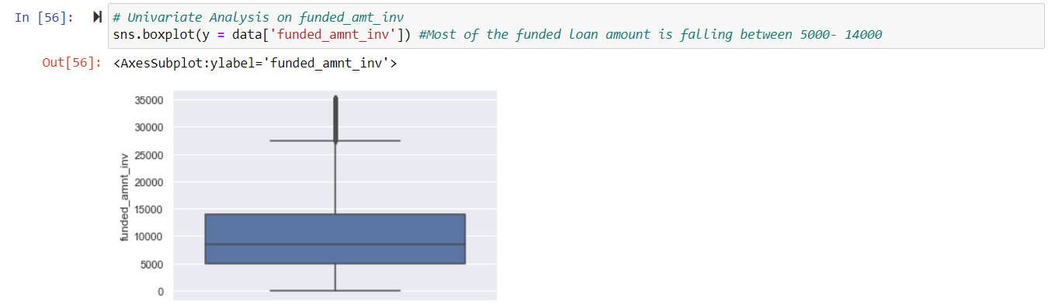
Univariate Analysis: funded_amnt_inv

Slide 9
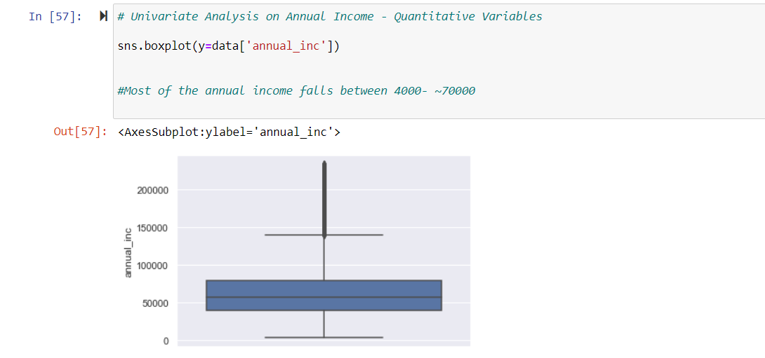
Univariate Analysis: annual_inc

Slide 10
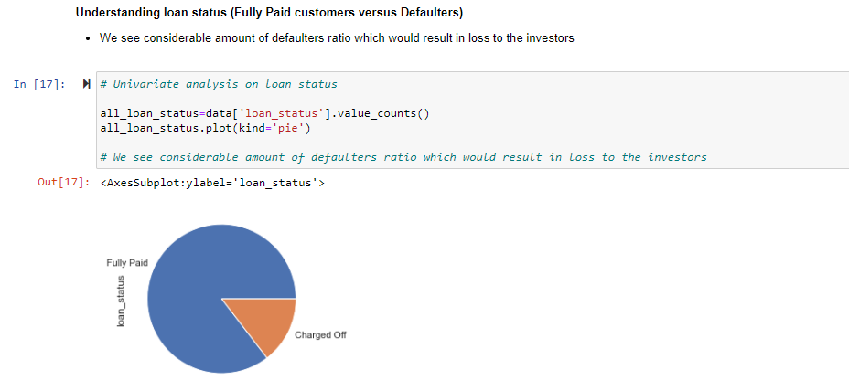
Univariate Analysis: loan_status

Slide 11
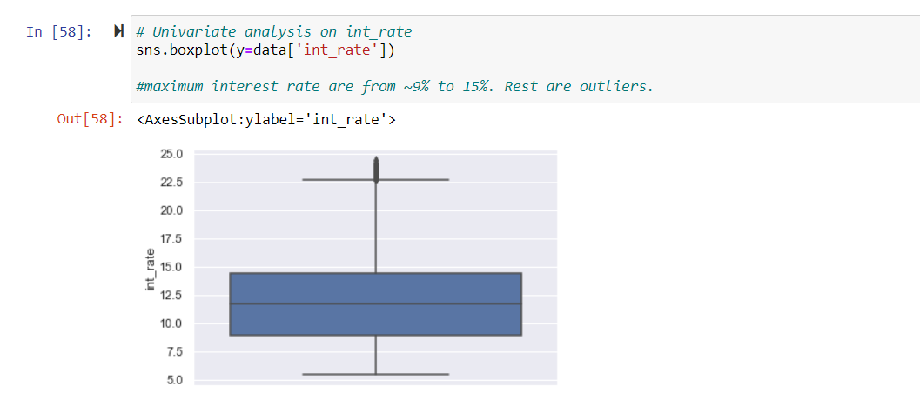
Univariate Analysis: int_rate

Slide 12
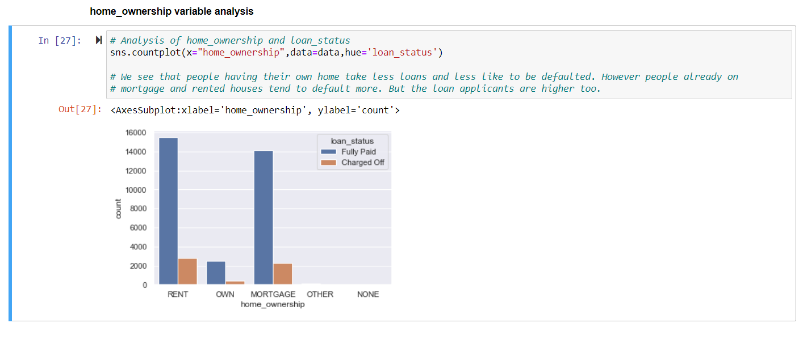
home_ownership vs loan_status

Slide 13
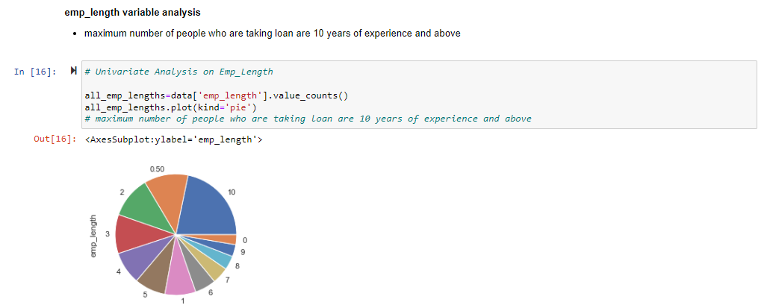
Univariate Analysis: emp_length

Slide 14
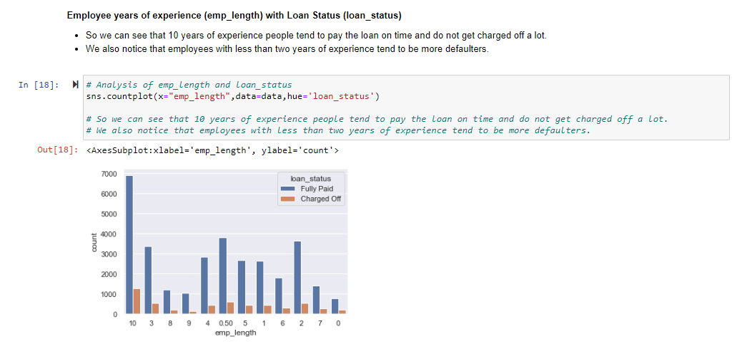
loan_status vs employee length

Slide 15
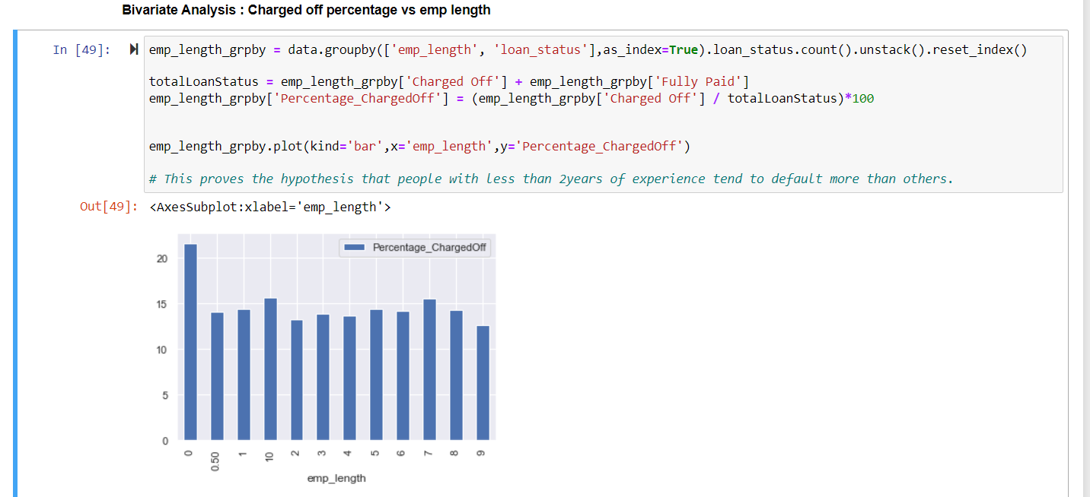
Bivariate Analysis: Charged off percentage vs emp length

Slide 16
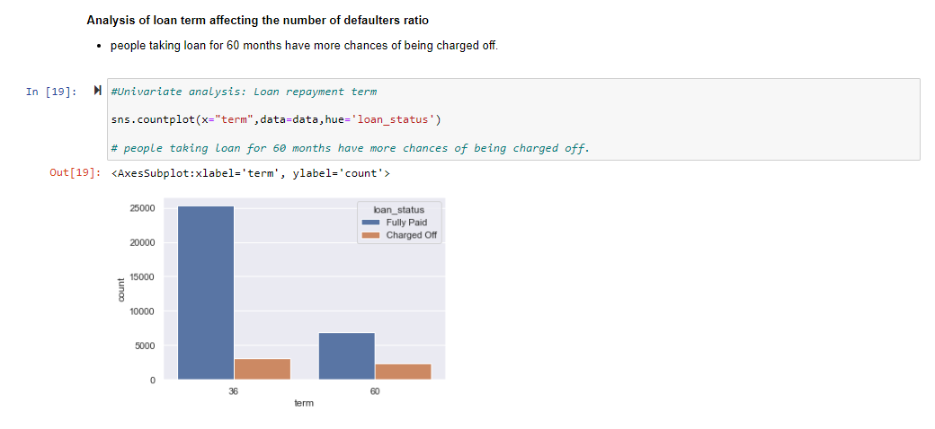
term vs loan_status

Slide 17
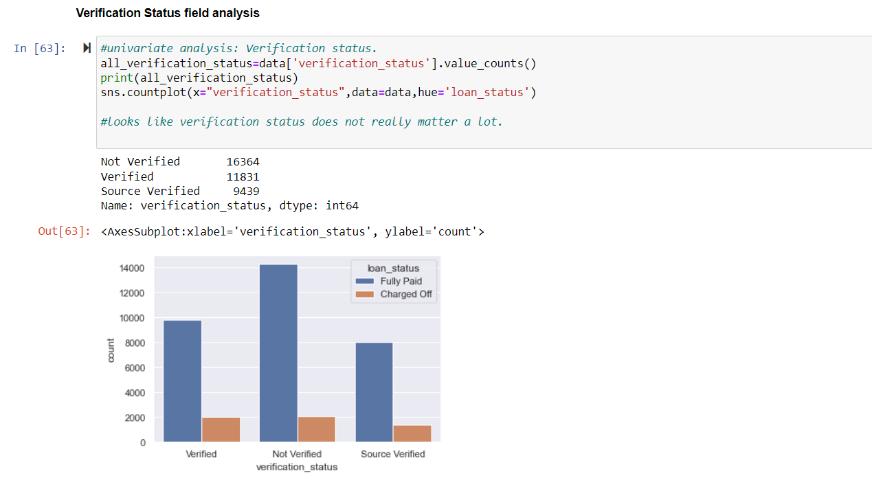
Univariate Analysis: Verification status

Slide 18
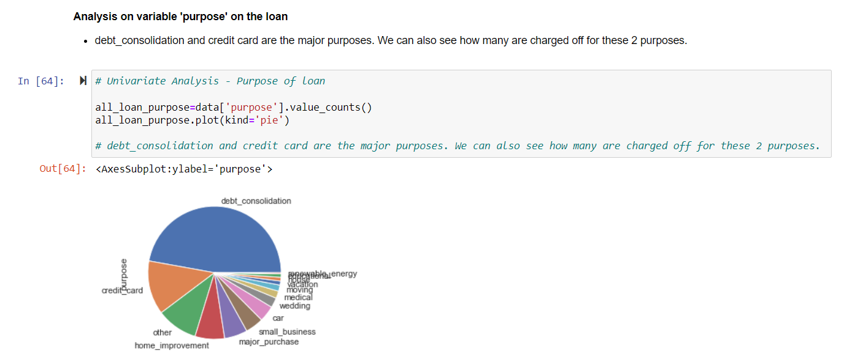
Univariate Analysis: Purpose

Slide 19
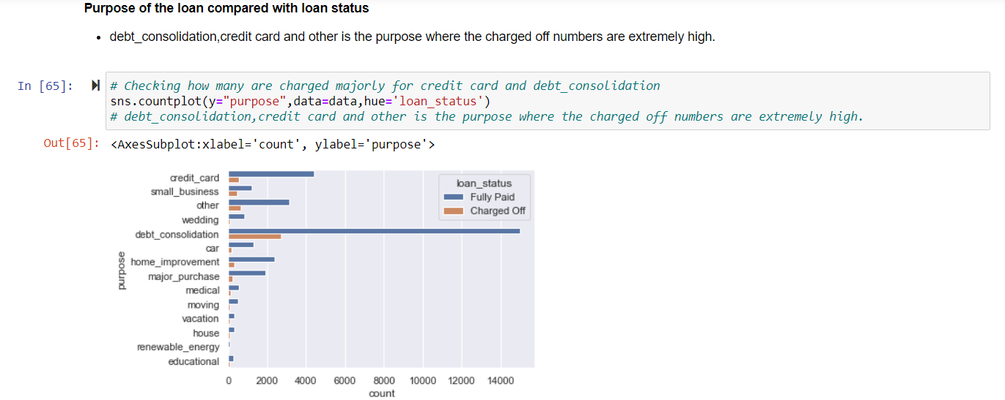
Purpose vs loan status

Slide 20
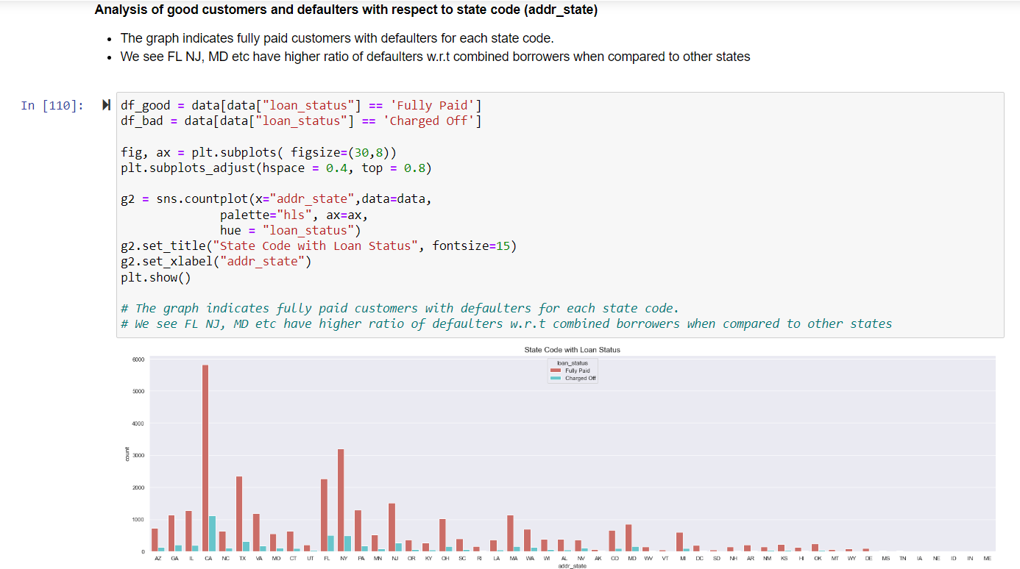
loan_status vs addr_state

Slide 21
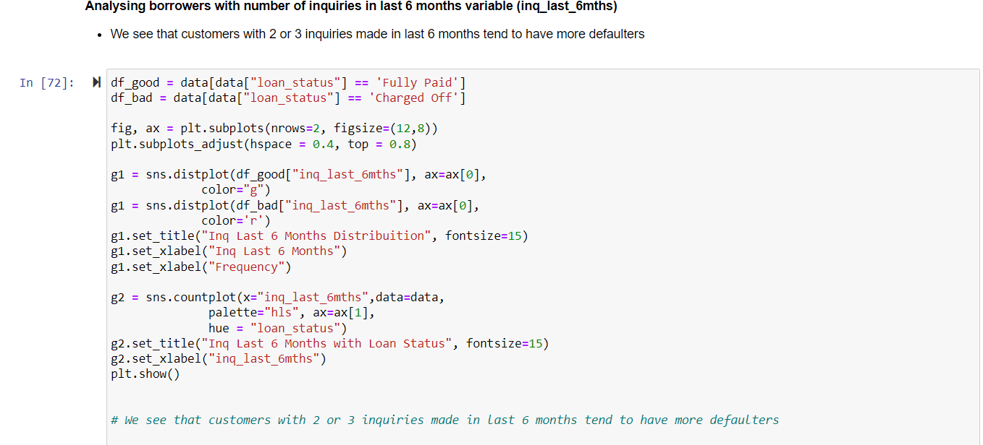
loan_status vs inq_last_6mnths

Slide 22
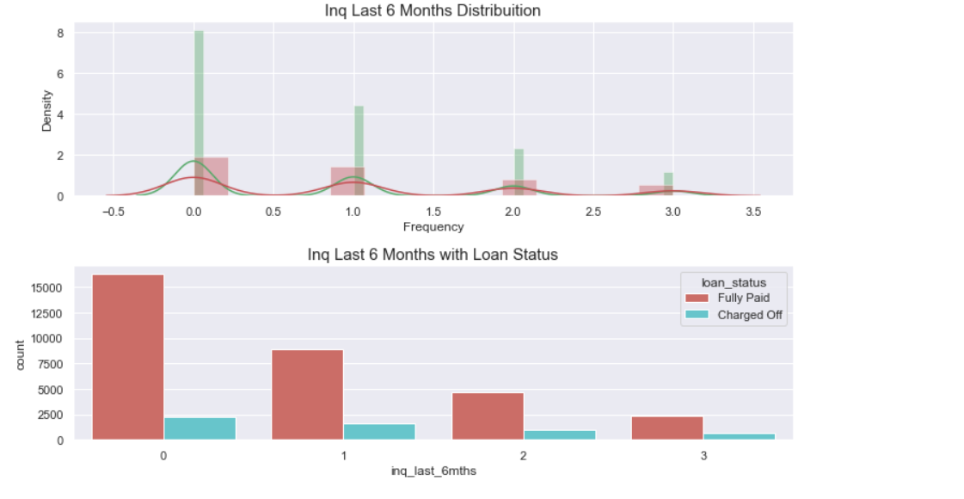
loan_status vs inq_last_6mnths

Slide 23
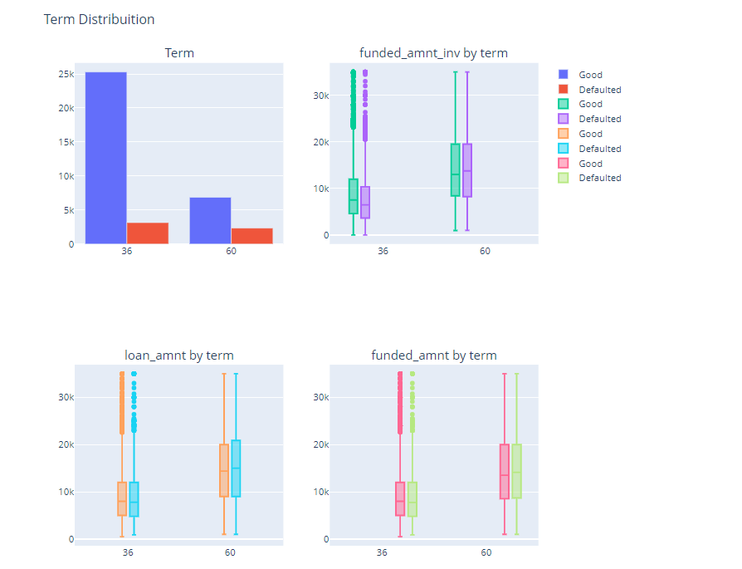
Loan amounts vs Term

Slide 24
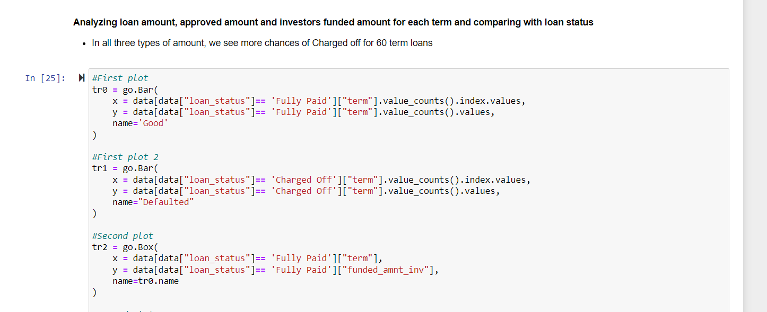
loan_amnt vs funded_amnt_inv vs funded_amnt

Slide 25
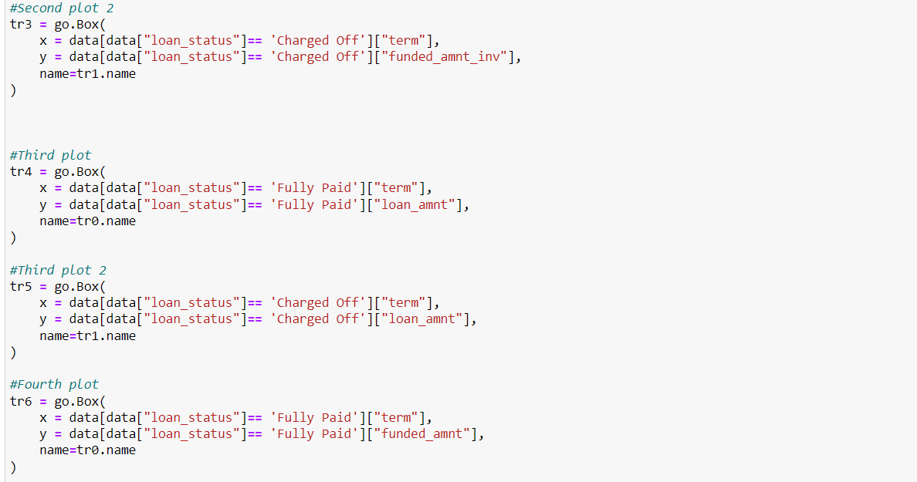
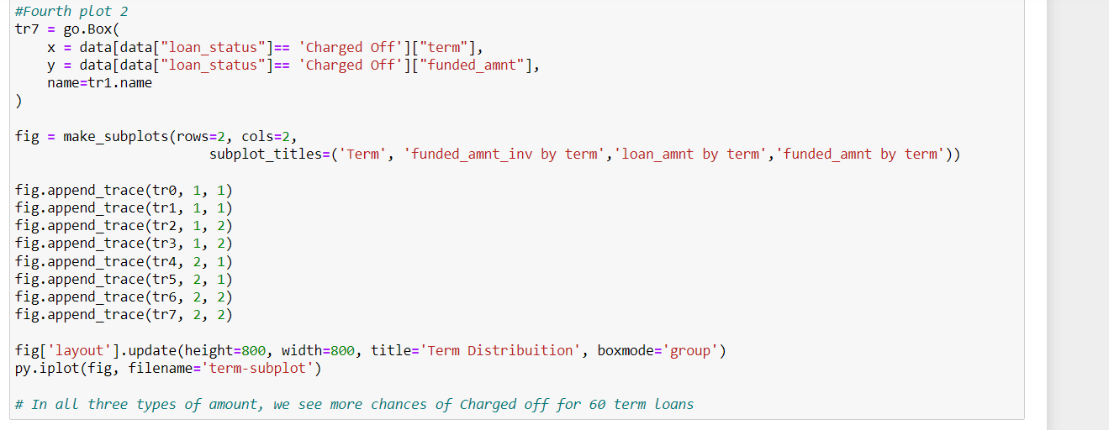
loan_amnt vs funded_amnt_inv vs funded_amnt

Slide 26
Recommendations – Based on analysis
People with 10 or more years of experience are less likely to be defaulted because of higher annual income and can be trusted to give a loan.
On the same lines the company should avoid giving loans to people having less then 2 years of experience as they tend to default more. Since raising interest might not help, the company can avoid giving loans to these bracket of people
People taking loan for 60 or more months have higher chances of being charged off. In this case, the company can raise the interest rate for giving loans for 60 or more months.
People having their own homes and taking loans should be highly trusted. However, we do understand from data that such proportion of people are less. The company should be cautious about giving loans to people on mortgaged homes and interest rate should be higher for these people.
Debt consolidation and credit card payment are the 2 areas where people taking loans default the most. The company should be aware before giving loans for these 2 purposes. Charging higher interest rate might be helpful in this area.
People from FL, NJ, MD have higher rate of defaulters as compared to the combined defaulters of other states. The company needs to be cautious before giving loans to people from these states. Charging higher interest rates from people of these states can be a helpful measure as they constitute a good number of people who take loans.
People making higher inquiries to take loans tend to default more against people making less enquiries. This can happen because a person making more enquiries for the loan is still trying to figure out a way to pay back and can try to negotiate for a lower interest rate over calls. Company needs to be cautious about these bracket of people.

